Slide 1
State Incentive Grant (SPF SIG) City of the Redlands Planning Session
December 3, 2012
M.J. Paschall, PhD – PRC
Rick McGaffigan, MSW - PRC

Slide 2
Introductions
Notes:
Go around room, Name, agency,

Slide 3
Why are we here today?
To frame the components of an action plan to reduce alcohol-related problems
Employ logic models to guide selection of evidence-based practices
Identify specific problem areas to focus on
Use DoView software to capture the key elements such as ….
Enforcement
Visibilty
Policy

Slide 4
Overview of the Day
Strategic Prevention Framework
What works ….
Logic Models
Key elements of comprehensive strategy
Strategic planning process using DoView
Next Steps
Schedule 2nd planning meeting

Slide 5
What does SAMHSA want?
To develop prevention infrastructure to support evidence-based interventions to….
Reduce excessive drinking among 12 to 25 year olds
Achieve that reduction at a community level
Demonstrate that achievement via formal evaluation

Slide 6
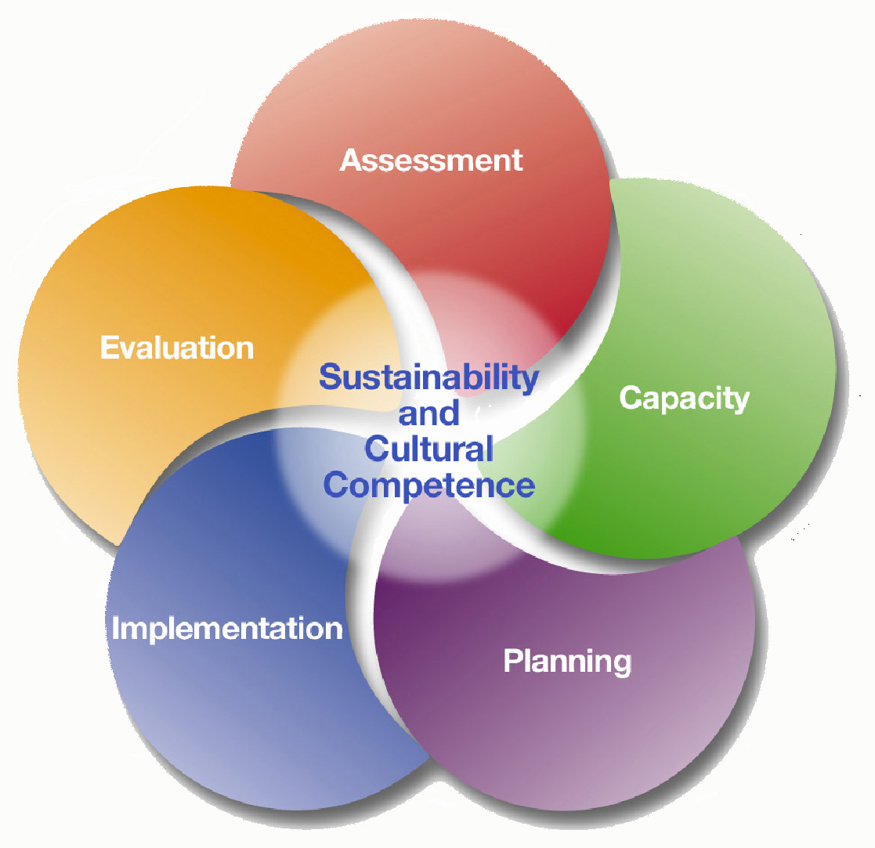

Slide 7
Streamlining the SPF Process
Assessment
Capacity building
Planning
Implementation
Evaluation

Slide 8
What Works
Effective intervention practices and programs
+
Effective implementation practices
= Good outcomes
No other combination of factors reliably produces desired outcomes
Fixsen, D. L., Naoom, S. F., Blase, K., Friedman, R. M., & Wallace, F., 2005

Slide 9
Effective Use of EBP
Stages
RESEARCH
IMPLEMENTATION
PRACTICE
Drivers
GAP
Fixsen, D. L., Naoom, S. F., Blase, K., Friedman, R. M., & Wallace, F., 2005

Slide 10
…so what’s our “driver?”
Logic Models

Slide 11
Logic Models
A tool to describe a theory of change underlying an intervention, policy, or program, i.e., how it’s supposed to work
Lays out a chain of events that leads from interventions to results
Clarifies knowledge of what works and why
Different types of logic models (e.g., theory of change vs. program logic)

Slide 12
Underage Drinking: Basic Research
Evidence: Population Prevention Effects
Strong
Moderate
Low (target group only)
None (no target or population)
Visible Enforcement
Retail Availability of Alcohol to Youth
Price
Alcohol-Related Problems
(Traffic crashes, Injuries,
School performance. Unsafe sex, Violence, etc.)
Social Availability of Alcohol to Youth
Underage Drinking Laws
Underage Drinking
Drinking Beliefs
Community Norms About Youth
Drinking
Family, School, and Peer Influence
Drinking Context
Alcohol Promotion (Advertising, Point of Sale Promotion , Sponsorship of Community Events)

Slide 13
Reward & Reminder
Retail Serving Practices
Decoy Operations
Nuisance Party Patrols
Social Host Liability
DUI Enforcement

Slide 14
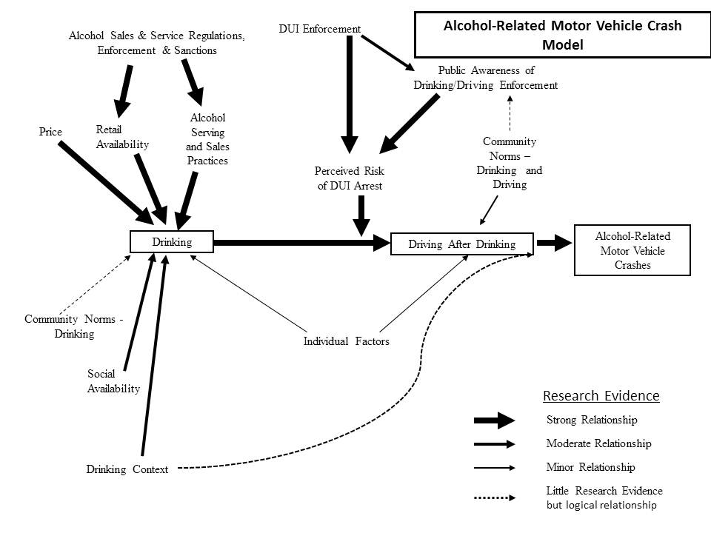

Slide 15
DUI Enforcement
Retail Serving Practices
Nuisance Party Patrols
Social Host Liability

Slide 16
How will we use these models?
To Develop a comprehensive Action Plan ….

Slide 17
Key Elements of the Approach
Prescriptive about what to do
Local expertise on how to do it
Highly focused on objectives rather than process
Move quickly through assessment and planning, and get into action
Focus on measurable community-level outcomes

Slide 18
So how do we move from concepts to action?
Very simple, interactive software designed for group strategizing
Focus is on the specific steps that will achieve a change in each main prevention target (e.g., “retail availability”)

Slide 19
Sample Page from Interactive Logic Model
Alcohol-Related Problems
(injury, school performance, unsafe sex)
Alcohol-Related Harm
Underage Drinking
30-day use; “binge” drinking
Price
Retail Availability of Alcohol to Youth
Social Availability of Alcohol to Youth
Alcohol Promotion
Drinking Context
Family, School, and Peer Influence
Drinking Beliefs
Average retail price of beer
Youth Buyer Survey
Sources of Alcohol
Point of Purchase Ads; General Advertising
Drinking Settings & Situations
Perceptions of Norms
Normative Beliefs
For software: www.doview.com

Slide 20
Sample Page from Interactive Logic Model (a level down from prior page)
Retail Availability of Alcohol to Youth
Social Availability of Alcohol to Youth
Retail Training & Rewards
Visible Enforcement
Underage Drinking Laws
Community Norms
about Youth Drinking
Adult Perceptions of Norms
Number of Compliance Checks, Shoulder Taps, Party Patrols
Compliance Checks, Citations, License Loss
Local Alcohol Policy
Party Patrol, Shoulder Taps, Keg Registration
Perceived Risk for Providing Alcohol to Underage
Media Advocacy
For software: www.doview.com

Slide 21
Social Availability of Alcohol
Youth Access to Home Alcohol Supply
Youth reports of alcohol availability in home
Alcohol Availability at Special Events
Parties/social events in which alcohol is available
Youth reports of number of social events in which alcohol is available
Parental drinking and provision of alcohol to other children
Youth reports of provisions of alcohol by adults, not their parents
Visible Police enforcement of social availability of alcohol to youth, e.g. party patrols
Explore Cloverdale Social Host Ordinance
Cloverdale Teen Party Ordinance
Provide information to adults about legal risks for providing alcohol to underage youth
Number of public information pamphlets and PSAs concerning legal risks
Monthly counts of news stories about legal risks
Monthly police enforcement actions to reduce social availability to youth.
Project SUCCESS Program
Every 15 Minutes Program
DARE Program
Boys & Girls Clubs Smart Moves Program & Parenting Class
Extreme Responders, Intro Law Enf. Classes
Citations, warnings, or arrests for providing alcohol to underage persons.

Slide 22
Framing a Comprehensive Strategy
Access issues (before)
Retail
Social
Drinking setting (context of use)
Party
Bars / restaurants
Enforcement (highly visible)
DUI enforcement
Party patrols
Local policies (alcohol control measures)

Slide 23
General Template for Assessment
Does an effective law exist?
Is the law enforced?
Can compliance be made easier?
Tips
Infrastructure
Is Enforcement highly visible?
To target audience
To general public

Slide 24
Action Plan Considerations
Targeting times:
Targeting places:
Focus of intervention:
Data needed to mobilize support:
Using logic models for EBP:
Tied to continuous monitoring and improvement:

Slide 25
Suggested Guide to DoView
Identify specific problem area
Select key component (e.g. retail access)
Work through key elements of component
Policy
Enforcement
Visibility
Supporting actions (e.g. RBS training)
Consider general assessment guidelines

Slide 26
“You've got to be careful if you don't know where you're going because you might not get there”
Yogi Berra

Slide 27
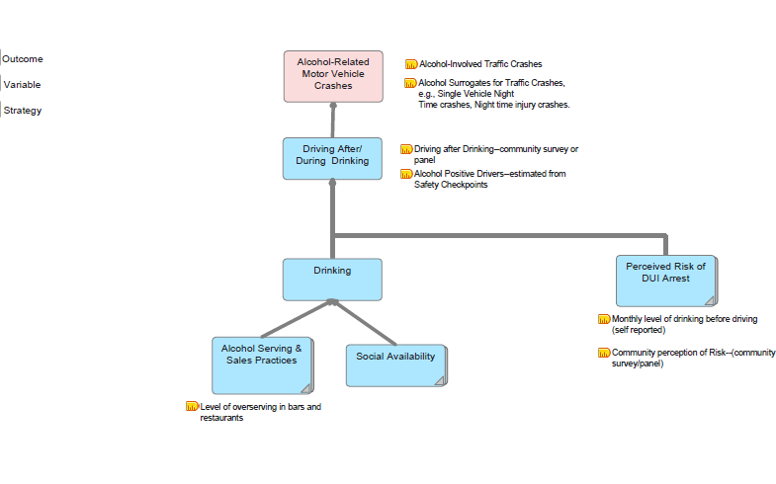

Slide 28
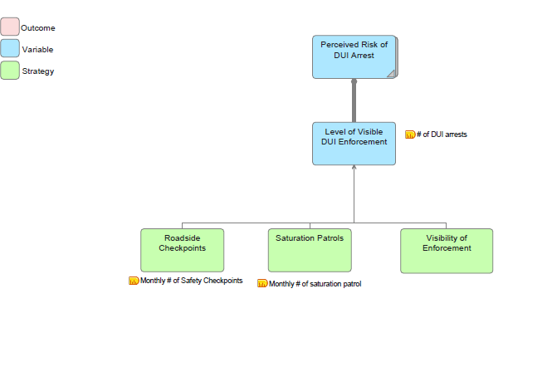

Slide 29
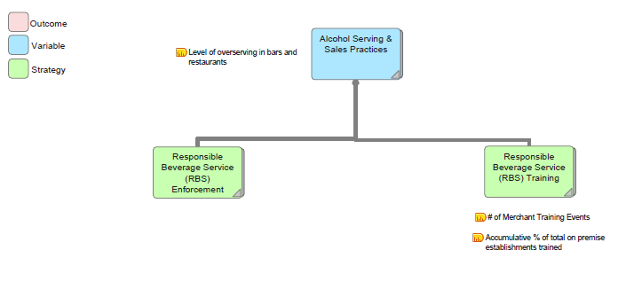

Slide 30
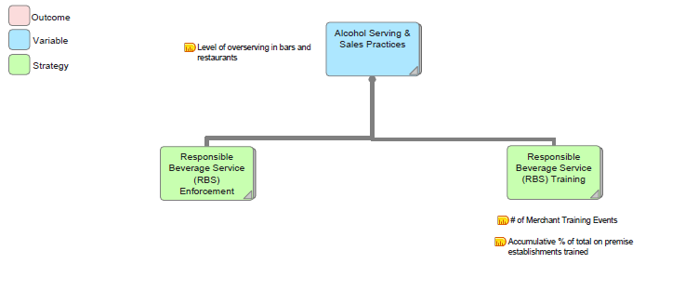

Slide 31
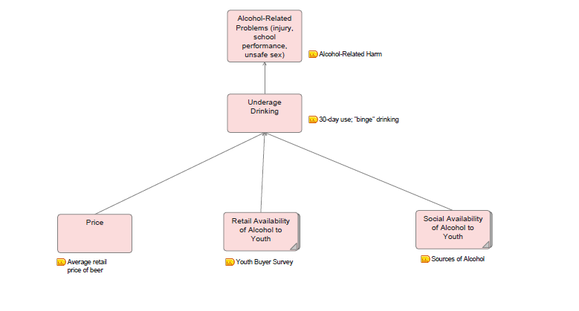

Slide 32
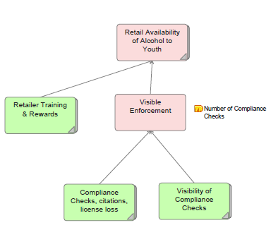

Slide 33
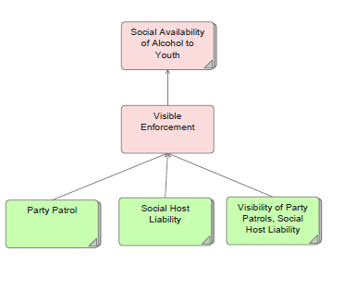

Slide 34
Quick break while we switch over to DoView

Slide 35
Next Steps…

Slide 36
Evaluation
How will we know that it worked?

Slide 37
Pre-condition Intervention “Post-condition”
“Black Box”

Slide 38
Sources
Minutes from planning meetings (already gathering)
Reports from counties and municipalities
Qualitative interviews with key personnel and planners

Slide 39
RBS Reporting Form
Activities | Date(s) | Degree of visibility
Develop contact list for licensed businesses
Number of alcohol outlets contacted
Number of alcohol outlets agreeing to train staff
RBS training
Visibility
Send out notices that RBS training is available
Develop a news release publicizing the problems that can be addressed by RBS
Develop materials (e.g., table tents) that on-premise outlets can use to educate patrons
Degree of visibility: | A: High visibility (Appeared in several outlets) | B: Some visibility (Two or three) | C: One mention | D: No visibility

Slide 40
Thank You!

